Slide 1
CHURN MODELING
BILJANA JOVANOVA, RAJESH CHODAVARAPU

Slide 2
What is Churn Modeling and Why is it important?
Acquiring new customers is more expensive than retaining existing customers.
How can predictive modeling help companies in their retention efforts?
Assign a risk profile or probability of churn
Understand what drives churn
Help management to create operational strategies to mitigate churn
The GOAL is to a build model which is both ACCURATE and INTERPRETABLE
Notes:
Using historic behavior to assign prob of churn

Slide 3
Our goals for this project
Apply classification models to open source dataset to answer a real-world business problem
Deal with imbalanced classes in the response
Study impact on the accuracy of predicting the event (churn | yes) and the overall accuracy of the model

Slide 4
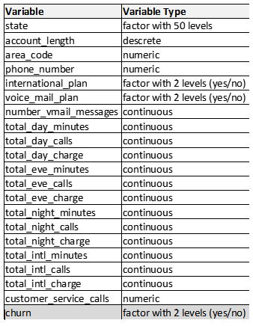
Telcom Churn Dataset
Source: Kaggle
Dimensions:
20 predictors
1 response
Churn | yes = 14%
Churn | no = 86%
5,000 observations

Slide 5
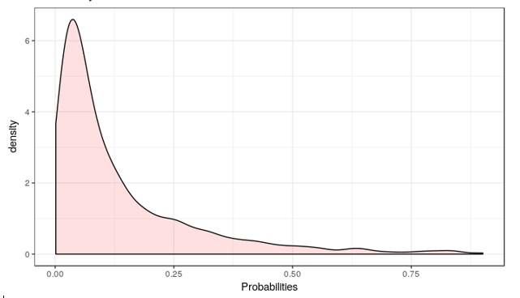
The Accuracy Paradox: Choosing the performance metric
Predictive power: accurately predict the problem of interest, in our case probability of positive churn event.
Predictive models with a given level of Sensitivity may have greater predictive power than models with higher overall accuracy.
performance is generally very biased against the class with the smallest frequencies
Predicted probabilities distribution for Churn | yes
COMPARE MODELS BASED ON SENSITIVITY and Kappa

Slide 6
Modeling Methodology
Methodology:
Start with a more complex model
Investigate simpler, more interpretable models
Choose simplest model which reasonably approximates the accuracy of complex model
For each model we will calculate:
Area Under the Curve (AUC), Sensitivity, Specificity, Kappa, Variable Importance
To study the effect of class imbalance:
Build all models with out-of-box probability threshold of 0.5
Use oversampling techniques
For logistic regression, classify based on best Youden’s J index which maximizes the Sensitivity metric

Slide 7
Data Splitting and Resampling
Data Splitting:
75% to Training set
25% to Test set
Resampling on the Training set :
10 fold cross validation with 5 repeats
For model fitting and tuning: provides good control over bias and variance and was computationally efficient

Slide 8
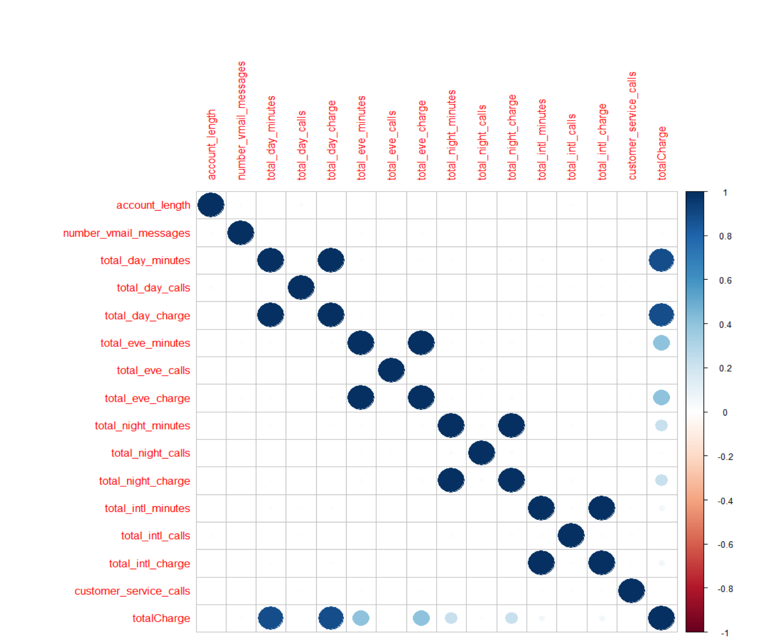
Exploratory Analysis on Training Set
High pairwise correlations
Ex: Total Day Charge vs Total Day Minutes, Total Intl Minutes vs Total Intl Charge…
Notes:
After performing the data splitting, we continue with the exploratory analysis on the training set.
-High Pairwise correlations

Slide 9
Exploratory Analysis for Training Set
Zero Variance Predictors
Ex: Number of Vmail Messages
Distributional Concerns: Imbalanced classes
Predictors: Intl Plan (no-91% |yes -9%), Voicemail Plan (no-74% | yes- 26%)
Response: Churn (no-86% | yes – 14%)
Uninformative variables
Ex: phone number, area code
Feature engineering:
Pricing component: calculate call rates for day, evening, and night calls
Total charges / Total minutes
Notes:
Feature Engineering, since we had a lot of usage metrics, we wanted to see if pricing is a churn indicator. Do some customers pay more that others?

Slide 10
Training Datasets
Full Training: original dataset
2. Reduced Training: removed zero variance and highly correlated predictors
3. Upsampled Training: reduced dataset Upsampled
4. SMOTE Training: reduced dataset resampled using SMOTE
Notes:
After the exploratory analysis we decided to run our models through four different training sets.
Full with all variables
Reduced
Furthermore we used oversampling techniques such as upsampling (sampling with replacement from the minority class) this results in equal class frequencies
SMOTE (syntetic minority oversampling technique) uses KNN model and combination between the up and down-sampling methods
IMPORTANT: Oversampling was not done on test data

Slide 11
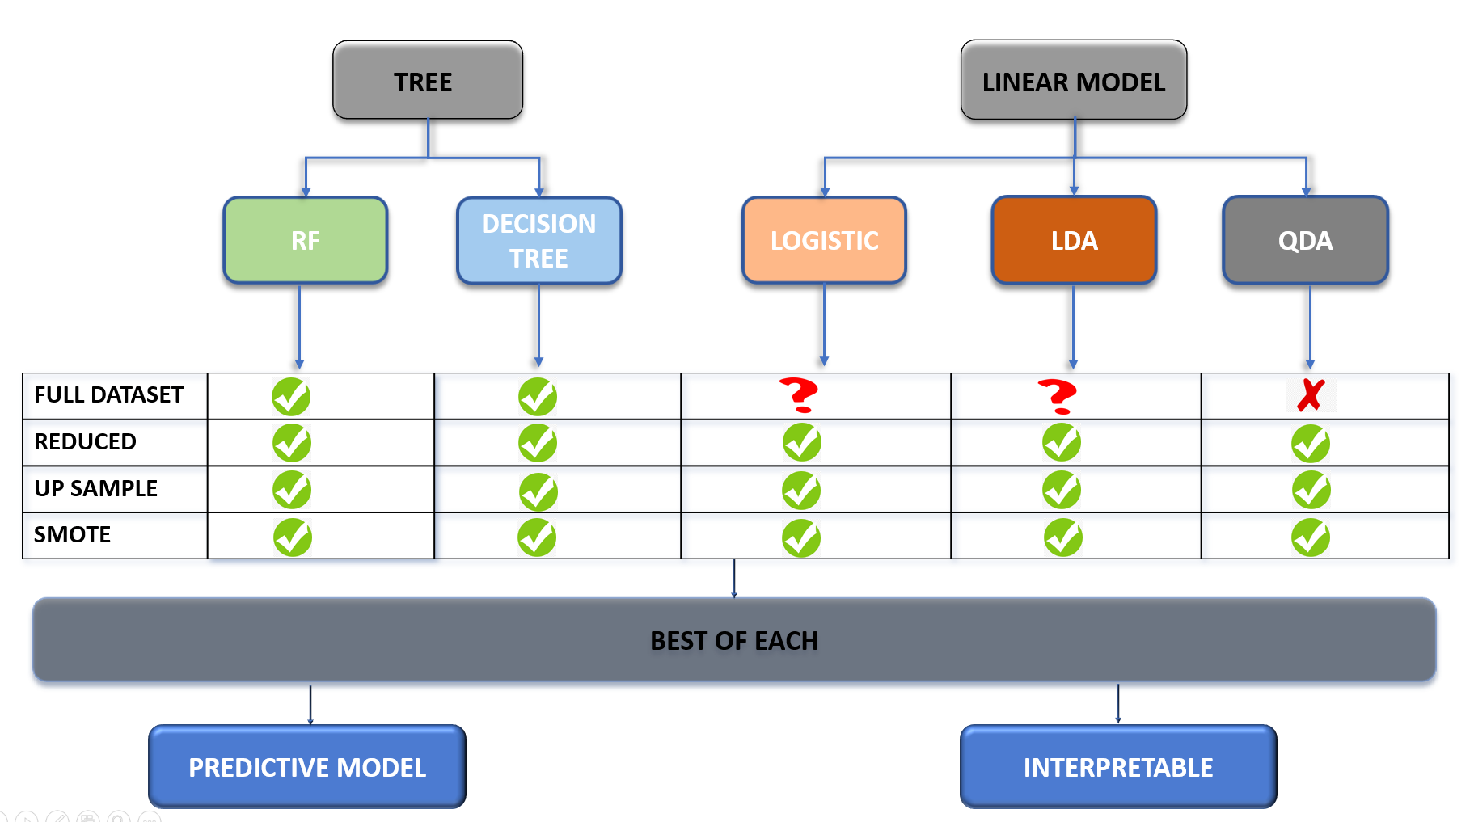
MODELING DIAGRAM
Notes:
Overall we fit two separate classes of models : Tree and Linear Based

Slide 12
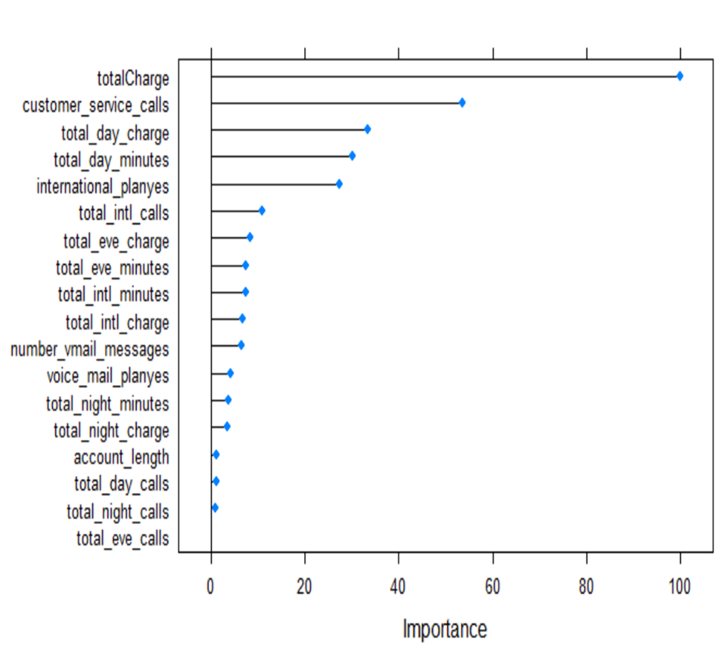
Random Forrest Models
Predictive Power:
Interpretability
Findings
Best Model : Training Full
Model insensitive to class imbalance
Different thresholds no significant improvement
Upsampling and Smote did not improve sensitivity
Most important variables for Best Model: Total Charge, Number of Service Calls, and Total Day Charge, but no quantifiable directional insight

Slide 13
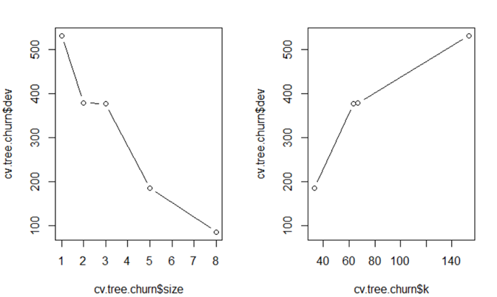
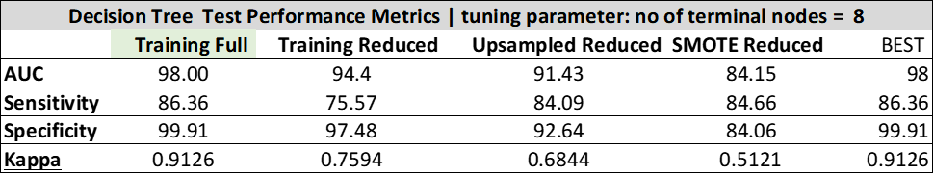
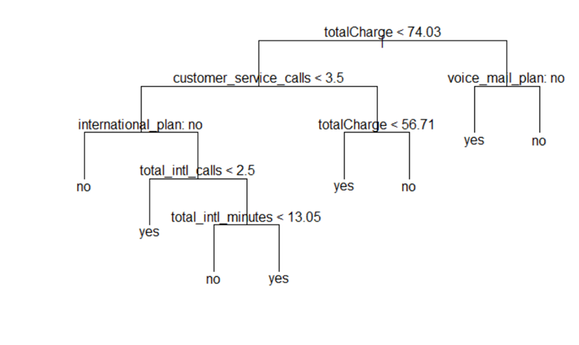
Decision Tree Models
Predictive Power:
Interpretability
Findings
Best Model : Training Full
Model insensitive to class imbalance
Different thresholds no significant improvement
Upsampling and Smote did not improve sensitivity
Useful interpretability : International plan (churners don’t use it, or use it most)
Notes:
Decision lines which result in predicted Churn | yes
If the customer is paying more than $74 and does not have a voice plan
If customer is paying less than $74, has had less than 3 service calls, has an international plan but has made less than 2 international calls
If customer is paying less than $74, has had less than 3 service calls, has an international plan but has made more than 2 international calls, and total number has more than 13 international minutes.

Slide 14
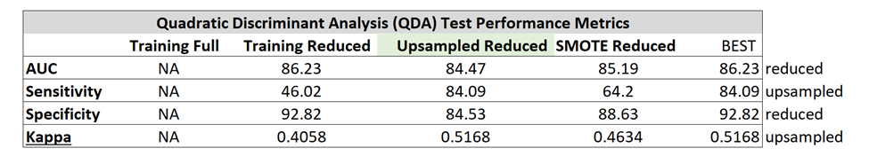
Quadratic Discriminant Analysis (QDA)
Predictive Power:
Interpretability:
QDA algorithm provides only group means
Findings
Best Model : Upsampled Reduced
Out of Box very sensitive to class imbalance (46% Sensitivity)
Upsampling was better than SMOTE
Not good interpretability

Slide 15
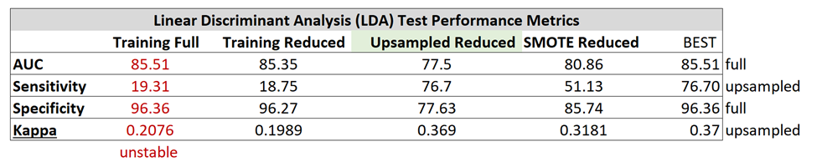
Linear Discriminant Analysis (LDA)
Predictive Power:
Interpretability
Provides LD coefficients, but no significance
Must use different packages for visuals
Findings
Best Model : Upsampled Reduced
Out of Box very sensitive to class imbalance (18% Sensitivity)
Upsampling was better than SMOTE
Not good interpretability

Slide 16
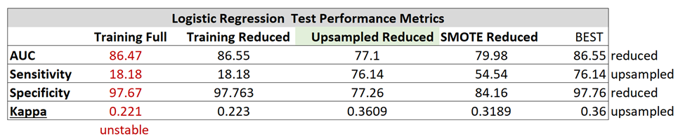
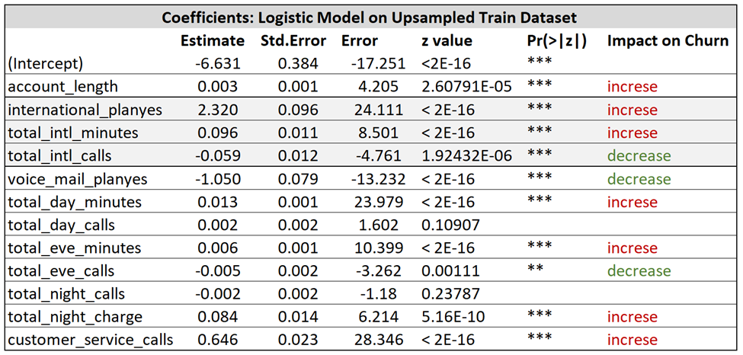
Logistic Regression
Predictive Power:
Interpretability
Findings
Best Model : Upsampled Reduced
Out of Box very sensitive to class imbalance
Upsampling was better than SMOTE
Good interpretability (impact on churn can be measured through the coefficients’ signs)

Slide 17
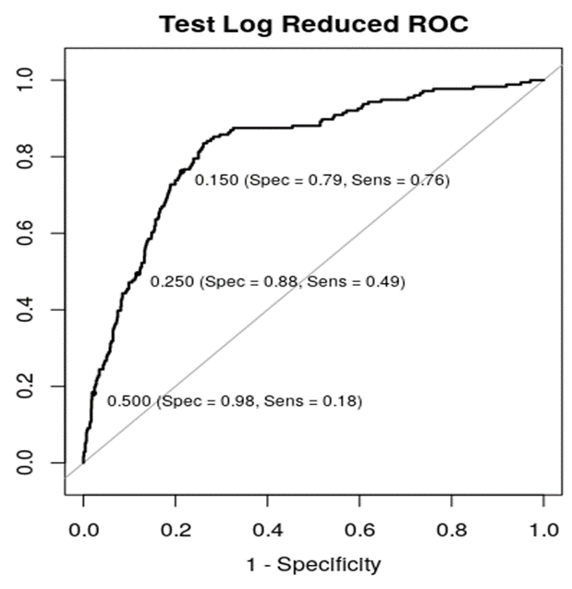

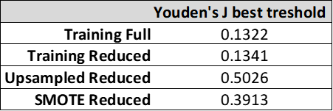
Adjusting Probability Threshold
Notes:
We wanted to try another method to improve the sensitivity as applied to the most interpretable model- Logistic Regression.
What happens when we move the classification boundary to the left (we move up the curve)

Slide 18
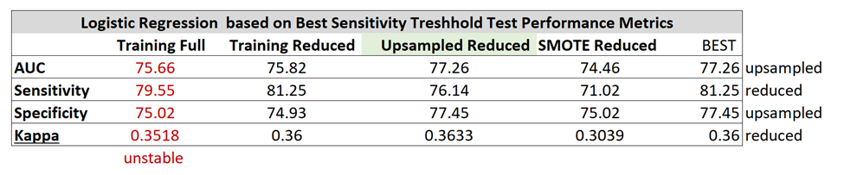
Logistic Regression based on Youden’s J
Predictive Power:
Interpretability
Same as previous Logistic model
Findings
Best Model : Training Reduced
Class imbalance remedied with manually adjusting the classes
Performance better than oversampling techniques
Good interpretability

Slide 19
Summary on Classification Models
Accuracy (Area Under the Curve) is not a good performance metric when we have imbalanced classes, we should use sensitivity and kappa for model selection purposes
For linear models:
running the models with a default threshold of 0.5 results in poor sensitivity
Sensitivity increased when upsampling and SMOTE techniques were used
Collinearity produced unstable parameter estimates
Removing highly correlated variables based on pairwise correlations can result in loss of predictive power (total charge variable)
Random Forrest performed very well regardless of the imbalance of the classes

Slide 20



CARET ENSEMBLE
INTERVIEWER 1 (MODEL 1)
INTERVIEWER 2 (MODEL 2)
CANDIDATE(INPUT)
MANAGER
(STACK OF MODELS)
RESULT (OUTPUT)
INTERVIEWER 3 (MODEL 3)
LIST OF MODELS

Slide 21
CARET ENSENMBLE
Ensembling:
Combining two or more algorithms
Types of Ensembling:
Averaging
Majority Vote
Weighted Average

Slide 22
CARET ENSEMBLE
SENSITIVITY STATISTICS
DATA SET | RF MODEL | ENSEMBLE RF MODEL
REDUCED SET | 76.7 | 80.11
UPSAMPLED SET | 79.54 | 86.93
CARET ENSEMBLE UP SAMPLE SET PREDICTION SUMMARY
RF | LOGISTIC | LDA | QDA | DT | EMSEMBLE(RF) | ACTUAL
0 | 0 | 0 | 0 | 0 | 0 | 0
0 | 1 | 1 | 0 | 0 | 0 | 0
0 | 0 | 0 | 0 | 0 | 0 | 0
0 | 1 | 1 | 1 | 0 | 0 | 1
1 | 1 | 0 | 0 | 1 | 1 | 1

Slide 23
CARET ENSEMBLE
Advantages
Improves accuracy
More robust and stable
Builds simple as well complex models
Disadvantages
Reduces Interpretability
Lack of business insights
Time consuming
Hard to master the model selection

Slide 24
Appendix

Slide 25
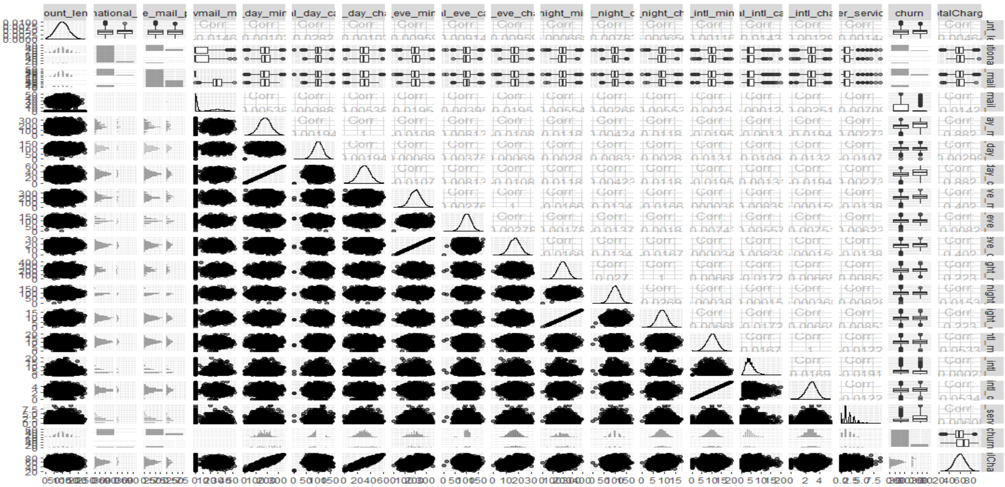
GGPAIRS PLOT: EXPLORATORY ANALYSIS

